Slide 1
WP2 Development of competence-based curricula aligned with EU trends (WP2.1, WP2.2, WP2.3) - Plans
Prinos Panagiotis
Skoulikaris Charalampos (Haris)
Aristotle University of Thessaloniki
Workshop on innovative practices in the EU water sector: barriers and opportunities / Vienna, 8-10 May 2019
This project has been funded with support from the European Commission. This publication reflects the views only of the author, and the Commission cannot be held responsible for any use which may be made of the information contained therein.

Slide 2
WP2: Development of competence-based curricula aligned with EU trends
WP2 implementation schedule:
Estimated Start Date | 15-11-2018 | Estimated End Date | 14-09-2020
Activity | Starting date | Due date
2.1 Development of specific competencies and learning outcomes of curricula in WB | 4/15/2019 | 14-10-2019
2.2 Development of courses content and syllabi | 5/15/2019 | 14-01-2020
2.3 Innovation of existing and development of new master curricula for WRM in WB | 5/15/2019 | 14-01-2020
2.4 Accreditation of master curricula | 12/15/2019 | 14-09-2020
2.5 Theme-based training of teaching staff for acquiring new teaching and learning methods | 5/15/2019 | 14-03-2020
2.6 Purchasing of literature, software and laboratory equipment, installation and activation | 1/15/2019 | 14-11-2019
Strengthening of master curricula in water resources management
for the Western Balkans HEIs and stakeholders
www.swarm.ni.ac.rs

Slide 3
WP2: Development of competence-based curricula aligned with EU trends
A/A | Institution | Country | Studying system | Program | Course | Year/ Semester | ECTS | Type
1 | University of Pristina in Kosovska Mitrovica/ Faculty of Technical Sciences | Kosovo | 4+1 | Undergraduate | Basics of Environmental Engineering | 1st/2nd | 4 | Μ
 |  |  |  |  | Hydro-technics | 2nd/ 4th | 6 | M
 |  |  |  |  | Hydro-technical infrastructure systems | 3rd/5th | 2 | E
 |  |  |  |  |  | 3rd/5th | 2 | E
 |  |  |  | Master | Design of Hydraulic Structures | 1st | 6 | M
2 | University of Montenegro/ Faculty of Civil Engineering | Montenegro | 3+2 | Master | MODULE 2 – WATER ENGINEERING | 2 years | 120
3 | University of Novi Sad/ Faculty of Technical Sciences | Serbia | 4+1 | Master | Water Treatment and Protection Engineering | 2 years | 120
Strengthening of master curricula in water resources management
for the Western Balkans HEIs and stakeholders
www.swarm.ni.ac.rs

Slide 4
WP2: Development of competence-based curricula aligned with EU trends
A/A | Institution | Country | Studying system | Program | Course | Year/ Semester | ECTS | Type
4 | University of Sarajevo/ Faculty of Civil Engineering | Bosnia & Herzegovina |  | Undergraduate | Hydromechanics | 2nd/ 3rd | 6 | M
 |  |  |  |  | Engineering hydrology | 2nd/ 4th | 4 | M
 |  |  |  |  | Engineering hydrology | 2nd/ 4th | 4 | Mandatory
 |  |  | 3+2 |  | Water Supply and Sewerage System | 3rd/5th | 6 | M
 |  |  |  |  | Hydraulic Structures | 3rd/6th | 4 | M
 |  |  |  | Master | Water Resources and Environmental Engineering | 2 years | 127
5 | University of Mostar/ Faculty of Civil Engineering | Bosnia & Herzegovina |  | Undergraduate | Hydromechanics
 |  |  |  |  | Engineering hydrology
 |  |  |  |  | Water supply and wastewater disposal
 |  |  |  |  | Hydrotechnical structures
 |  |  |  | Master | Graduate Study Programme: General
 |  |  |  |  | Graduate Study Programme: Environmental Infrastructure Management
Strengthening of master curricula in water resources management
for the Western Balkans HEIs and stakeholders
www.swarm.ni.ac.rs

Slide 5
WP2: Development of competence-based curricula aligned with EU trends
A/A | Institution | Country | Studying system | Program | Course | Year/ Semester | ECTS | Type
6 | University of Nis / Faculty of Civil Engineering and Architecture | Serbia | 4+1 | Undergraduate | Bachelor academic studies – Civil Engineering
 |  |  |  | Master | Master academic studies – Civil Engineering - Module Hydraulic Engineering
7 | Technical College of Applied Sciences Urosevac-Leposavic | Serbia |  |  | No study programmes or courses related to water resources management
Strengthening of master curricula in water resources management
for the Western Balkans HEIs and stakeholders
www.swarm.ni.ac.rs

Slide 6
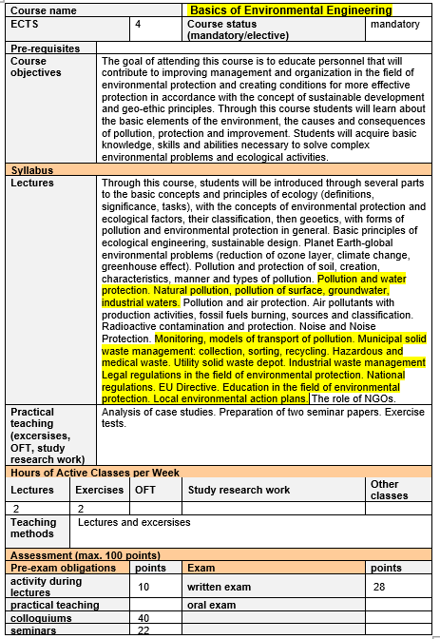
University of Pristina in Kosovska Mitrovica/Faculty of Technical Sciences
Undergraduate study program
4 Courses related to Water and The
Environment
Strengthening of master curricula in water resources management
for the Western Balkans HEIs and stakeholders
www.swarm.ni.ac.rs

Slide 7
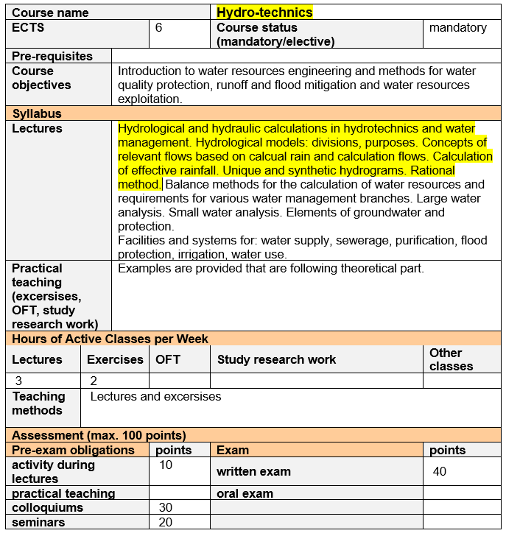
University of Pristina in Kosovska Mitrovica/Faculty of Technical Sciences
Undergraduate study program
Strengthening of master curricula in water resources management
for the Western Balkans HEIs and stakeholders
www.swarm.ni.ac.rs

Slide 8
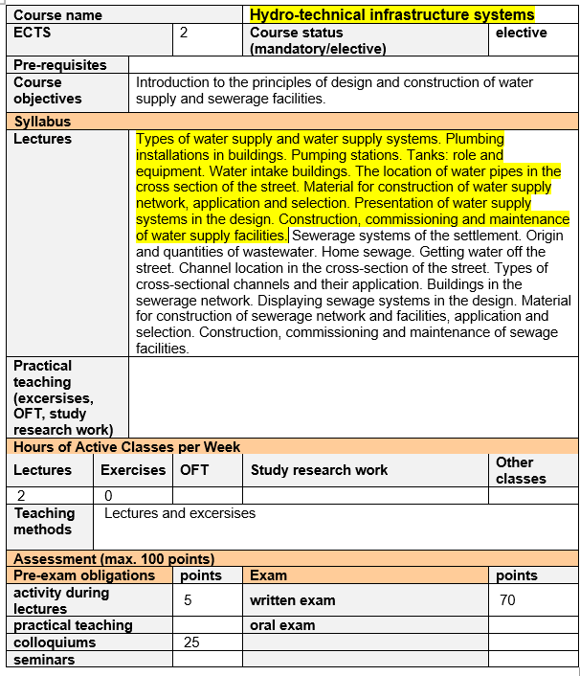
University of Pristina in Kosovska Mitrovica/Faculty of Technical Sciences
Undergraduate study program
Strengthening of master curricula in water resources management
for the Western Balkans HEIs and stakeholders
www.swarm.ni.ac.rs

Slide 9
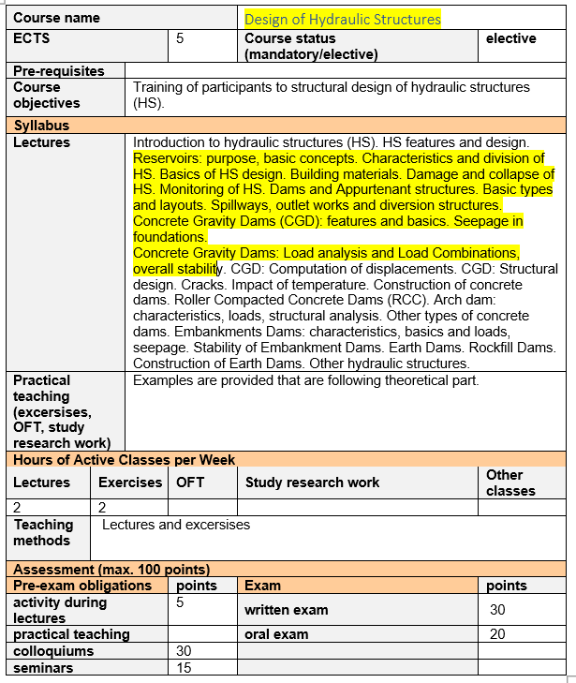
University of Pristina in Kosovska Mitrovica/Faculty of Technical Sciences
Undergraduate study program
Strengthening of master curricula in water resources management
for the Western Balkans HEIs and stakeholders
www.swarm.ni.ac.rs

Slide 10
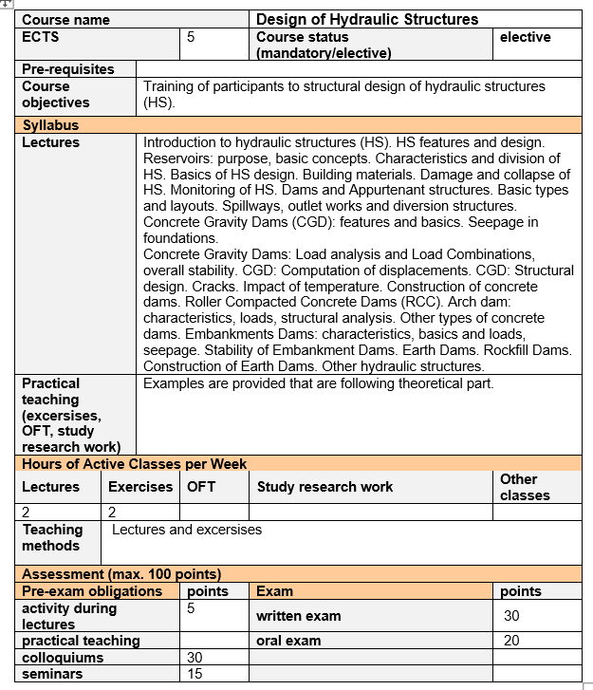
University of Pristina in Kosovska Mitrovica/Faculty of Technical Sciences
Master study program
1 Course related to Water
Strengthening of master curricula in water resources management
for the Western Balkans HEIs and stakeholders
www.swarm.ni.ac.rs

Slide 11
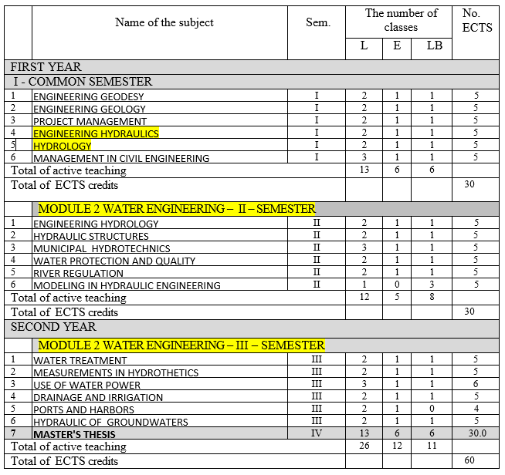
University of Montenegro/ Faculty of Civil Engineering
MASTER STUDIES– CIVIL ENGINEERING INFRASTRUCTURE –MODULE 2 – WATER ENGINEERING
Strengthening of master curricula in water resources management
for the Western Balkans HEIs and stakeholders
www.swarm.ni.ac.rs

Slide 12
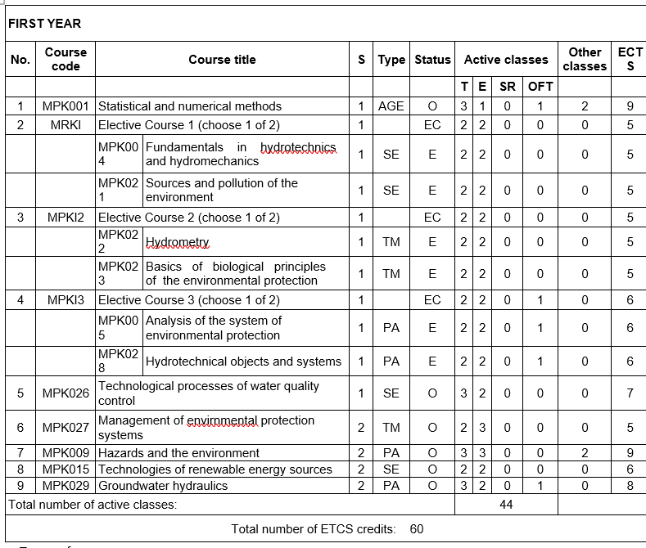
Department of Environmental Engineering and Occupational Safety and Health, Faculty of Technical Sciences, University of Novi Sad
MASTER:
Water Treatment and Protection Engineering
Strengthening of master curricula in water resources management
for the Western Balkans HEIs and stakeholders
www.swarm.ni.ac.rs

Slide 13
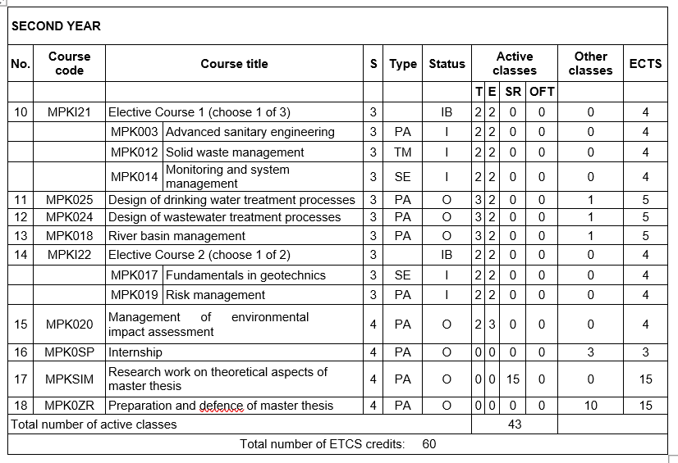
Department of Environmental Engineering and Occupational Safety and Health, Faculty of Technical Sciences, University of Novi Sad
MASTER:
Water Treatment and Protection Engineering
Strengthening of master curricula in water resources management
for the Western Balkans HEIs and stakeholders
www.swarm.ni.ac.rs

Slide 14
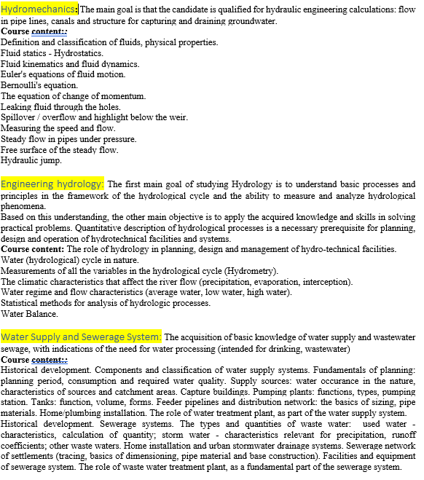
University of Sarajevo/Faculty of Civil Engineering
Undergraduate study program
Strengthening of master curricula in water resources management
for the Western Balkans HEIs and stakeholders
www.swarm.ni.ac.rs

Slide 15
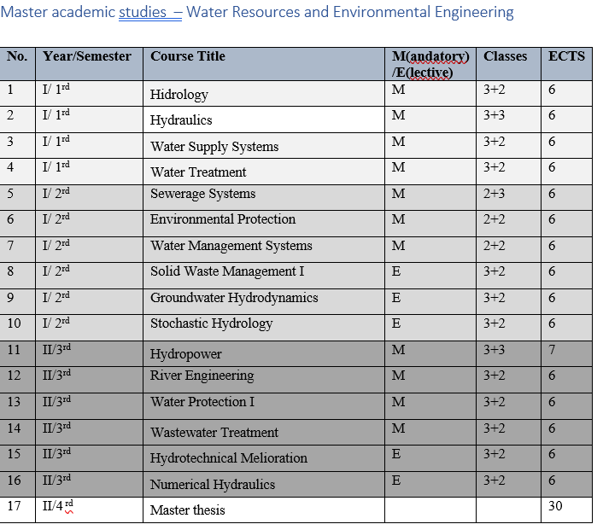
University of Sarajevo/Faculty of Civil Engineering
Master
Strengthening of master curricula in water resources management
for the Western Balkans HEIs and stakeholders
www.swarm.ni.ac.rs

Slide 16
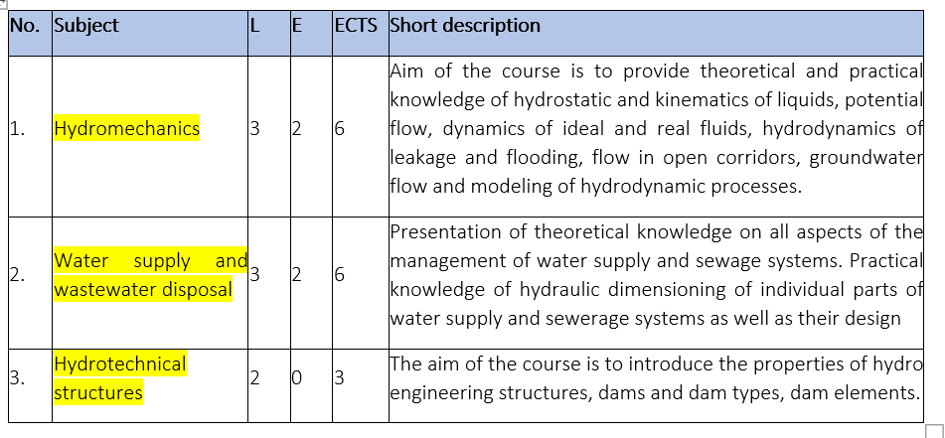
University of Mostar/ Faculty of Civil Engineering
Undergraduate studies
Strengthening of master curricula in water resources management
for the Western Balkans HEIs and stakeholders
www.swarm.ni.ac.rs

Slide 17
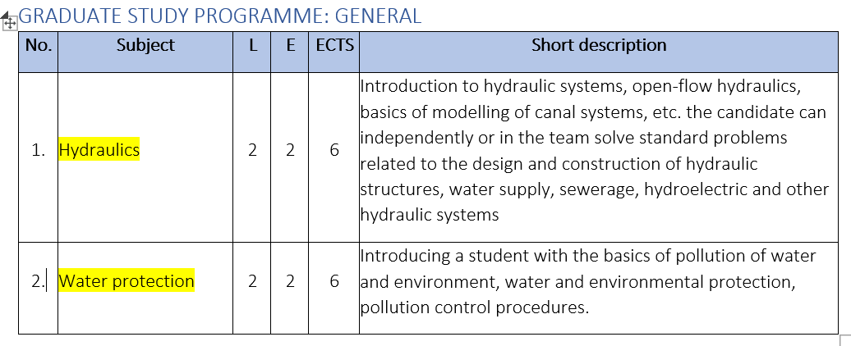
University of Mostar/ Faculty of Civil Engineering
Master: general courses
Strengthening of master curricula in water resources management
for the Western Balkans HEIs and stakeholders
www.swarm.ni.ac.rs

Slide 18
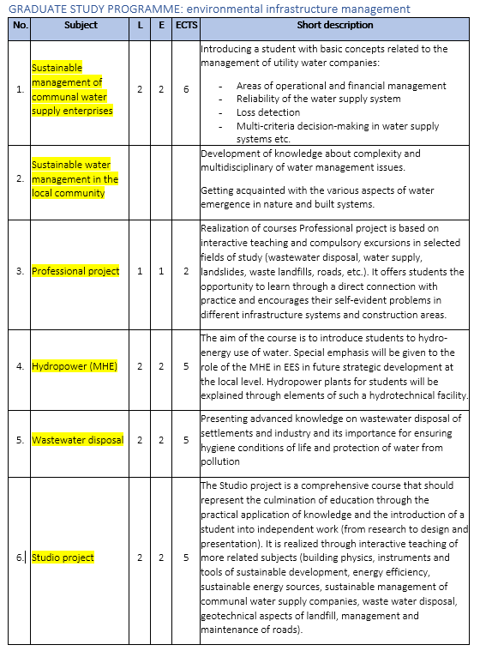
University of Mostar/ Faculty of Civil Engineering
Master: general courses
Strengthening of master curricula in water resources management
for the Western Balkans HEIs and stakeholders
www.swarm.ni.ac.rs

Slide 19
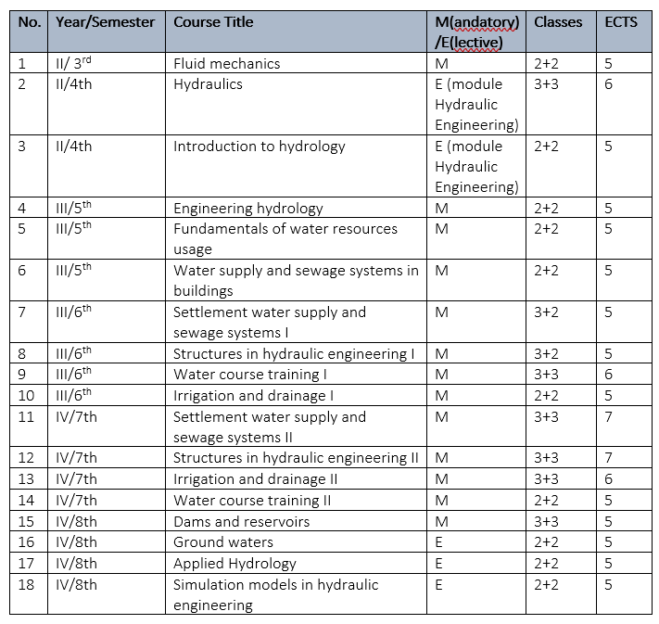
University of Nis
Faculty of Civil Engineering and Architecture
Bachelor
Strengthening of master curricula in water resources management
for the Western Balkans HEIs and stakeholders
www.swarm.ni.ac.rs

Slide 20
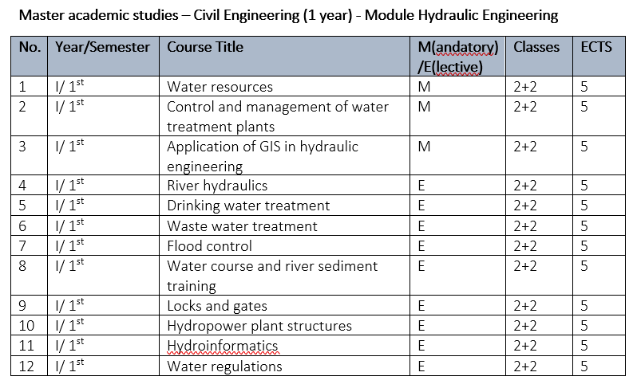
University of Nis
Faculty of Civil Engineering and Architecture
Master
Strengthening of master curricula in water resources management
for the Western Balkans HEIs and stakeholders
www.swarm.ni.ac.rs

Slide 21
WP2: Development of competence-based curricula aligned with EU trends
Results of preliminary communication process:
A/A | University/Institution | Synopsis of communication outputs
1 | University of Pristina in Kosovska Mitrovica/ Faculty of Technical Sciences | 1 new course in undergraduate level (hydrology?) 1 new course at master level (XXX) Upgrading of existing curricula
2 | University of Montenegro/ Faculty of Civil Engineering | A) Development of laboratory exercises and experiments
3 | University of Novi Sad/ Faculty of Technical Sciences
4 | University of Sarajevo/ Faculty of Civil Engineering | Upgrading of 3-4 specific courses
5 | University of Mostar/ Faculty of Civil Engineering
Strengthening of master curricula in water resources management
for the Western Balkans HEIs and stakeholders
www.swarm.ni.ac.rs

Slide 22
WP2: Development of competence-based curricula aligned with EU trends
Results of preliminary communication process:
A/A | University/Institution | Synopsis of communication outputs
6 | University of Nis / Faculty of Civil Engineering and Architecture | New master programme on Engineering Management
7 | Technical College of Applied Sciences Urosevac-Leposavic
Strengthening of master curricula in water resources management
for the Western Balkans HEIs and stakeholders
www.swarm.ni.ac.rs

Slide 23
WP2: Development of competence-based curricula aligned with EU trends
A2.5 Theme-based training of teaching staff for acquiring new teaching and learning methods
Six three-day trainings of WB teaching staff (15 WB staff per training) will be organized in EU partner HEIs. EU partners will prepare six reports after the events and one general report specified part-by-part what WB staff have achieved.
Strengthening of master curricula in water resources management
for the Western Balkans HEIs and stakeholders
www.swarm.ni.ac.rs

Slide 24
WP2: Development of competence-based curricula aligned with EU trends
A2.6 Purchasing of literature, software and laboratory equipment
Public procurement procedures regarding purchasing laboratory equipment, software and literature in WB partner countries will be executed. Seven laboratories in WB partner HEIs will be equipped and used in preparing new laboratory exercises.
Strengthening of master curricula in water resources management
for the Western Balkans HEIs and stakeholders
www.swarm.ni.ac.rs

Slide 25
Ευχαριστώ!
Strengthening of master curricula in water resources management
for the Western Balkans HEIs and stakeholders
www.swarm.ni.ac.rs

